Slide 1
STAC67 Final Project
Alex Cheng, Zaamin Rattansi, Jacob Temple, Jeffrey Wong

Slide 2

Introduction
The purpose of this research is to study the direct and indirect relationships of metrics for Mashable news articles and the amount an article was shared by readers. This will be done through thorough analysis of the variables that have an effect on the number of shares of an article. Variables that are directly related, and variables that have less importance were included to see the largest range of relationships possible and to really understand what affects the amount an article is shared by Mashable users.

Slide 3

Background
The data we have analyzed and studied is taken from a multi-platform media company called Mashable. The data was taken to analyze the number of shares a new article receives in relation to various other variables. The chosen variables had some relation to the amount an article may be shared and our models show the importance of some factors vs others regarding the amount an article may be shared. There may be many other factors that cause a post to be shared, however, we can only analyse the data that has been collected.

Slide 4
Study Goal
We will analyze what variables cause an increase or decrease in the number of shares to learn more about what future articles require in order to be shared more by Mashable users.

Slide 5
Description of Dataset
The data was cleaned mainly be eliminating variables that were either redundant to the number of shares or if similar variables were used.
For example, we removed any max and min variables and instead used the average variables. It was unnecessary to use all three, the max, min, and average, when we can just use the average variables.
We also removed all the LDA variables since they are irrelevant to the following analysis.
It was also important to remove the baseline variables for categorical variables as the data already provides factored categorical variables (Weekday and Data Channel). Also removed were variables that had perfect collegiality, e.g., is_weekend.

Slide 6
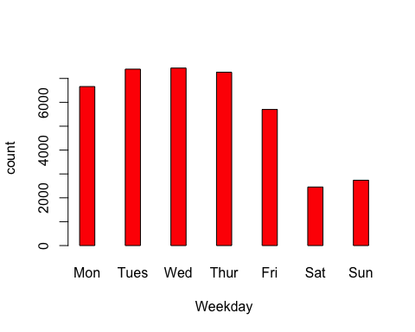
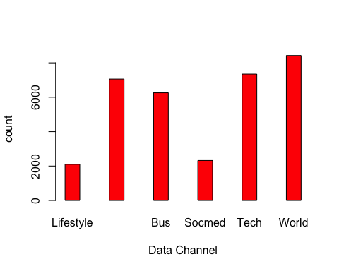
Preliminary Investigation of Data

Slide 7
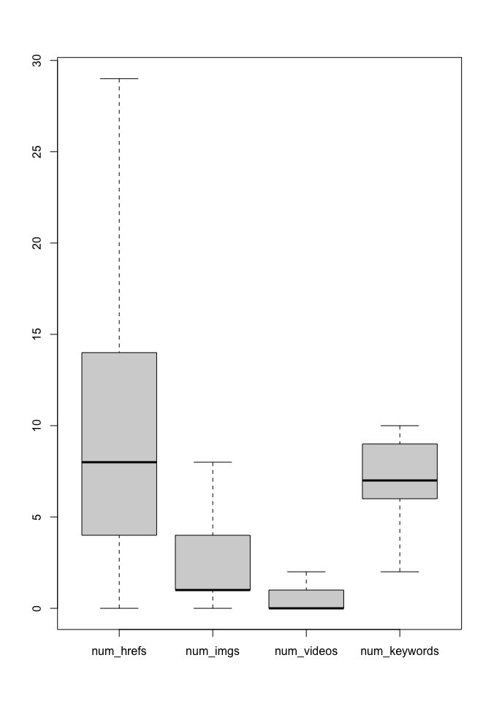
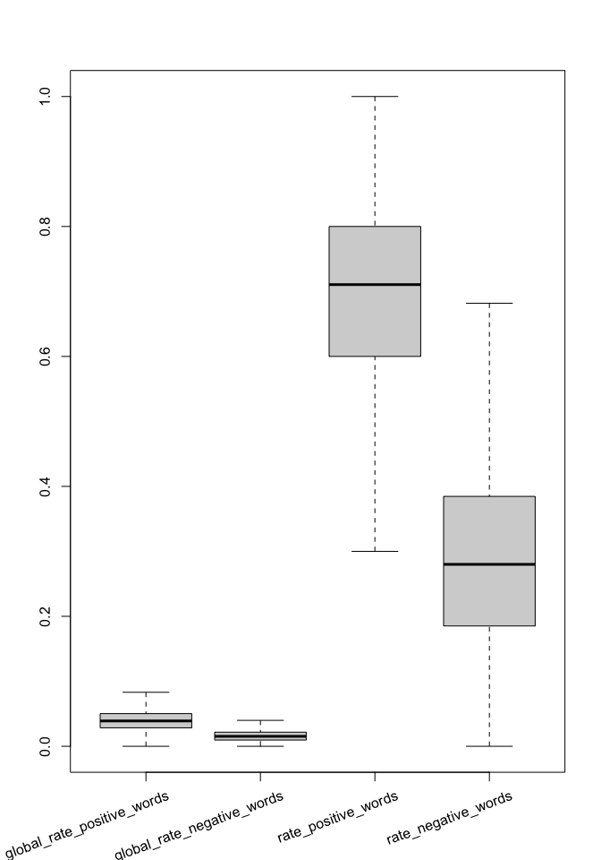

Slide 8
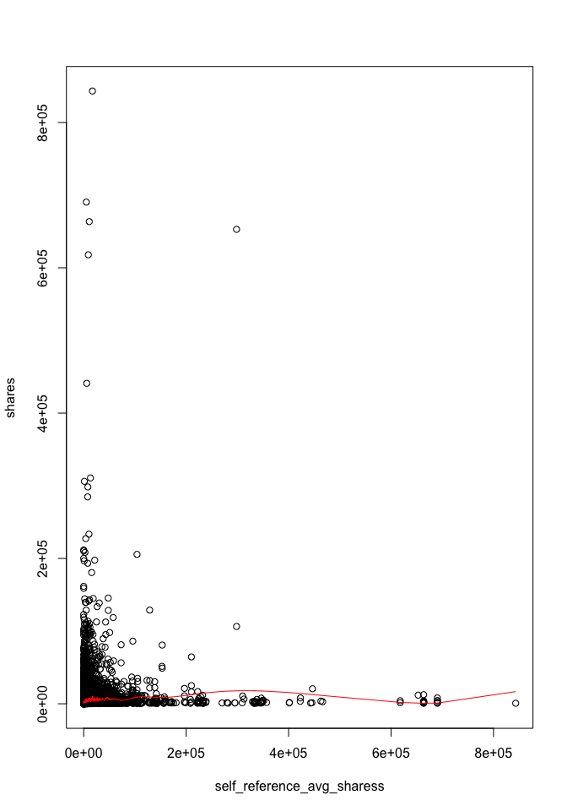
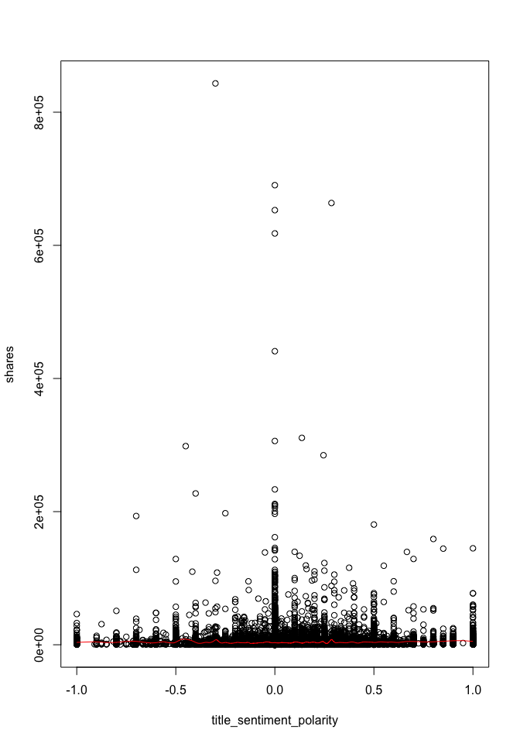

Slide 9
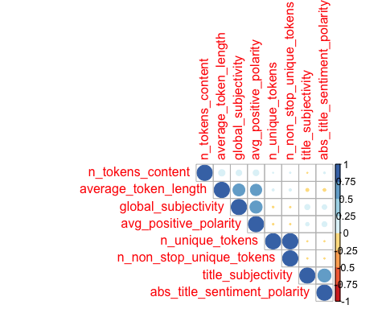

Slide 10
Model Building

Slide 11
Full Model With Interactions
## $sigma ## [1] 10464.04 ## ## $df ## [1] 125 19724 125 ## ## $r.squared ## [1] 0.07146069 ## ## $adj.r.squared ## [1] 0.06562319 ## ## $fstatistic ## value numdf dendf ## 12.24166 124.00000 19724.00000

Slide 12
Model 1 - Stepwise Regression of Full Model
## $sigma ## [1] 10533.72 ## ## $df ## [1] 36 19813 36 ## ## $r.squared ## [1] 0.05480761 ## ## $adj.r.squared ## [1] 0.05313791 ## ## $fstatistic ## value numdf dendf ## 32.82486 35.00000 19813.00000

Slide 13
Model 2 - Subset Regression on Model 1
## $sigma ## [1] 10533.32 ## ## $df ## [1] 30 19819 30 ## ## $r.squared ## [1] 0.05459331 ## ## $adj.r.squared ## [1] 0.05320995 ## ## $fstatistic ## value numdf dendf ## 39.4643 29.0000 19819.0000

Slide 14
Model Diagnostics
The number of outliers:
## [1] 96
Number of leverage points:
## [1] 915
Number of influential points (DFFITS & DFBETAS):
## [DFFITS] 385
## [DFBETAS] 7369
We removed all outliers, leverage points, and influential points.

Slide 15
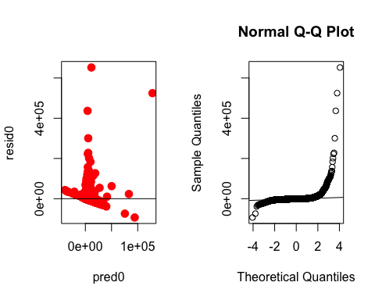
Model 3 - Full Model Before and After log Transformation

Slide 16
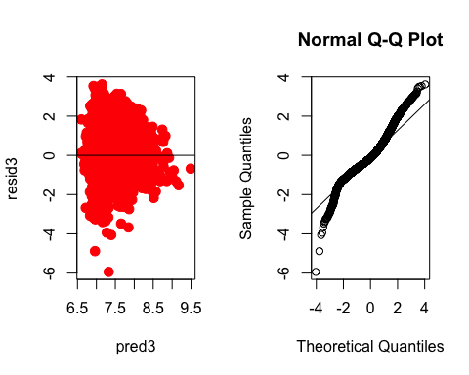

Slide 17
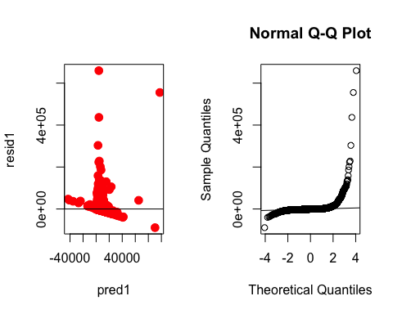
Model 4 - Model 1 Before and After log Transformation

Slide 18
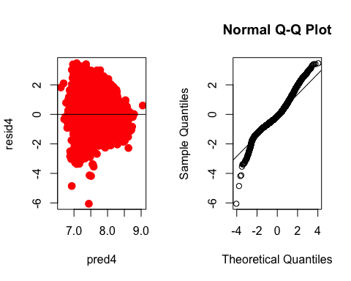

Slide 19

Model 5 - Model 2 Before and After log Transformation

Slide 20
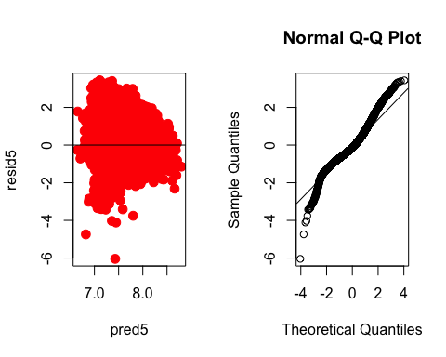

Slide 21
PRESS Statistics for Models 0-5
## [0] 4.24814e+13
## [1] 2.345082e+12
## [2] 2.340874e+12
## [3] 11593.87
## [4] 11993.85
## [5] 12073.8
Variables with VIF >10 for Model 5:
## self_reference_min_shares 2 ## self_reference_max_shares 9 ## self_reference_avg_sharess 10 ## self_reference_max_shares:global_subjectivity 19 ## self_reference_max_shares:self_reference_avg_sharess 20 ## self_reference_avg_sharess:global_subjectivity 22 ## kw_avg_avg:self_reference_avg_sharess 23 ## self_reference_avg_sharess:num_keywords 28

Slide 22
Model 6 - Model 5 After removing Variables with High VIF
## $sigma ## [1] 0.8053047 ## ## $df ## [1] 22 18669 22 ## ## $r.squared ## [1] 0.09032009 ## ## $adj.r.squared ## [1] 0.08929683 ## ## $fstatistic ## value numdf dendf ## 88.26683 21.00000 18669.00000

Slide 23
Model Validation
Difference between MSPE and MSE for Models 3-6
## [1] 164935068
## [1] 164935151
## [1] 164935334
## [1] 164932973

Slide 24
Conclusion

Slide 25
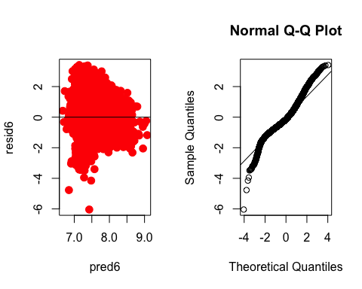
Final Model
## Call: ## lm(formula = paste("log(shares) ~", vars6, sep = " "), data = new_build) ## ## Residuals: ## Min 1Q Median 3Q Max ## -6.0402 -0.5270 -0.1366 0.4237 3.4092 ## ## Coefficients: ## Estimate Std. Error ## (Intercept) 7.010e+00 4.359e-02 ## kw_avg_avg 2.118e-04 7.552e-06 ## num_hrefs 5.300e-03 1.231e-03 ## avg_negative_polarity -2.166e-01 5.666e-02 ## average_token_length -2.657e-02 8.583e-03 ## num_self_hrefs -5.561e-03 4.348e-03 ## weekday_is_monday -1.070e-01 4.114e-02 ## data_channel_is_lifestyle -4.626e-02 2.707e-02 ## kw_avg_max -9.103e-07 6.257e-08 ## num_hrefs:num_imgs -9.741e-05 8.022e-05 ## average_token_length:num_imgs 1.132e-03 3.299e-04 ## avg_negative_polarity:data_channel_is_entertainment 6.829e-01 5.165e-02 ## num_hrefs:num_self_hrefs 1.587e-04 1.958e-04 ## avg_negative_polarity:weekday_is_monday -1.834e-01 1.441e-01 ## average_token_length:kw_avg_min -7.964e-06 4.747e-06 ## weekday_is_monday:self_reference_max_shares -9.365e-06 3.794e-06 ## weekday_is_monday:self_reference_avg_sharess 2.439e-05 6.132e-06 ## self_reference_avg_sharess:self_reference_min_shares -1.766e-10 4.576e-11 ## num_hrefs:self_reference_avg_sharess -1.657e-08 1.157e-07 ## num_self_hrefs:self_reference_avg_sharess 1.901e-06 4.851e-07 ## kw_avg_max:self_reference_avg_sharess 3.438e-11 6.072e-12 ## self_reference_avg_sharess:num_videos -1.323e-07 2.082e-07 ## --- ## Signif. codes: 0 '***' 0.001 '**' 0.01 '*' 0.05 '.' 0.1 ' ' 1 ## ## Residual standard error: 0.8053 on 18669 degrees of freedom ## Multiple R-squared: 0.09032, Adjusted R-squared: 0.0893 ## F-statistic: 88.27 on 21 and 18669 DF, p-value: < 2.2e-16
t value Pr(>|t|) 160.829 < 2e-16 *** 28.038 < 2e-16 *** 4.304 1.68e-05 *** -3.822 0.000133 *** -3.096 0.001963 ** -1.279 0.200877 -2.602 0.009279 ** -1.708 0.087563 . -14.548 < 2e-16 *** -1.214 0.224642 3.430 0.000605 *** 13.222 < 2e-16 *** 0.811 0.417474 -1.273 0.203186 -1.678 0.093390 . -2.469 0.013572 * 3.977 7.01e-05 *** -3.860 0.000114 *** -0.143 0.886090 3.920 8.89e-05 *** 5.662 1.51e-08 *** -0.635 0.525162

Slide 26
Obstacles
Notably missing are Brown-Forsyth and Shapiro-Wilks tests for equal and normally distributed variance due to R’s processing limitations with our large data set. This is more or less accommodated by the Residual Plots against predicted values and Normal Q-Q Plots.
Additionally, the data provided better lends itself to a multivariate analysis given the large number of variable which is out of the scope of this course.

Slide 27
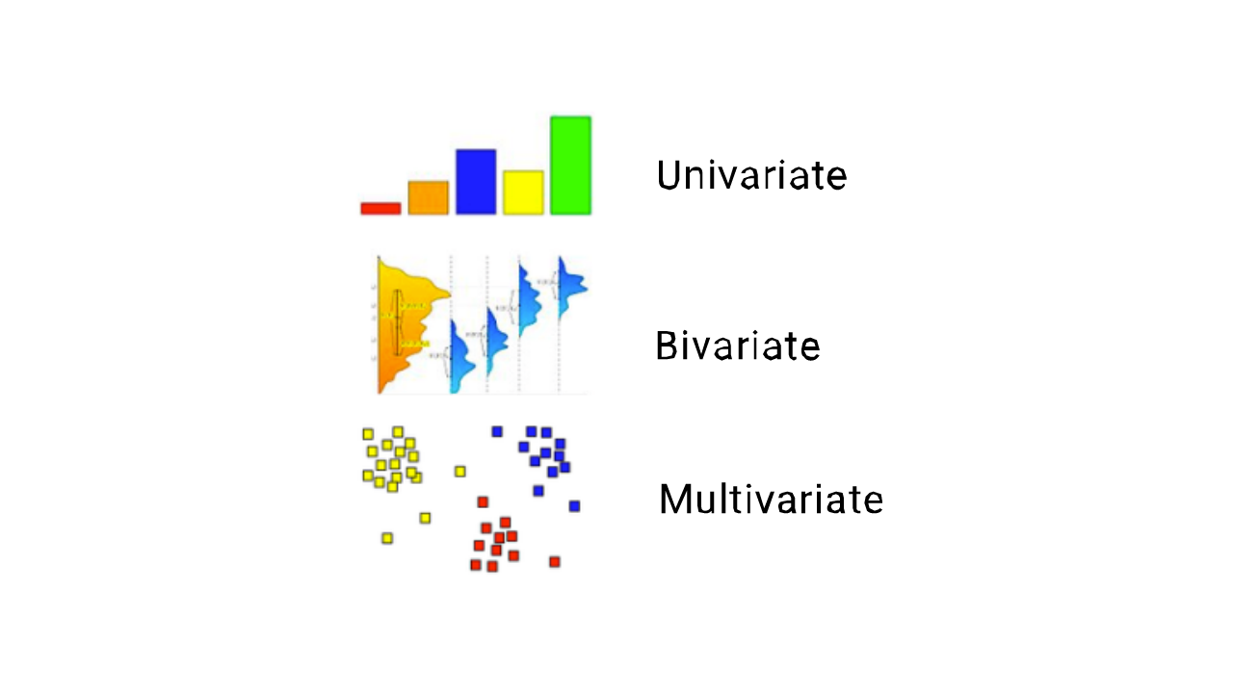
Next Steps
One might perform a multivariate analysis on the given data while using technology that is able to adequately handle the large amount of data.

